Slide 1

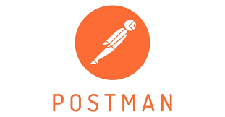

Postman: Revolutionizing API Development
Today, we'll dive into Postman, the transformative SaaS platform that's revolutionizing how developers build, test, and manage APIs. Discover how Postman empowers developers to streamline their workflows and enhance productivity in API development.

Slide 2
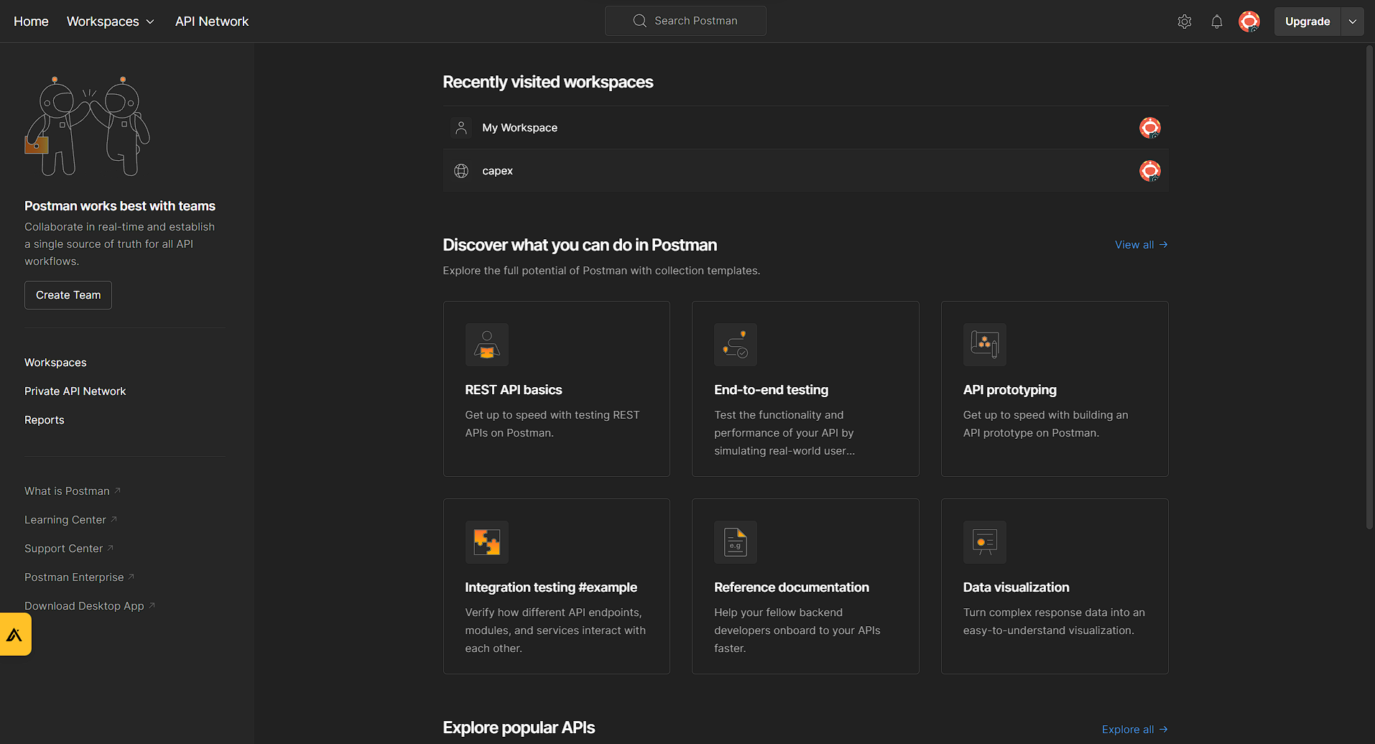
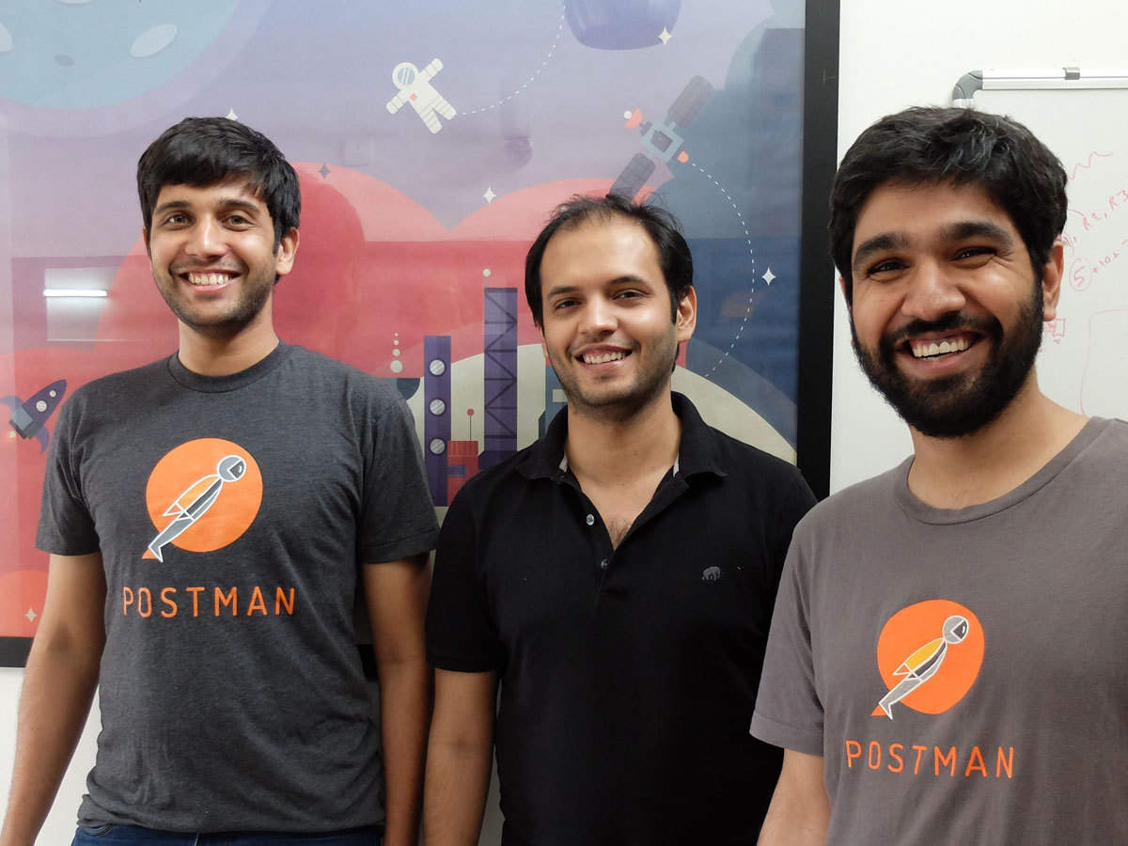
From API Client to Platform
Postman's Journey
Key Developments
Postman started as a simple API client, but quickly grew into a powerful suite of tools for all phases of API development. Now, it's a fully-fledged SaaS platform used by millions of developers worldwide.
Postman started by 3 friends, has now evolved to include features for API design, testing, documentation, collaboration, monitoring, and more.

Slide 3


Features
API Development
Testing and Debugging
Create, build, and manage your APIs with Postman's intuitive interface.
Ensure your APIs work flawlessly with comprehensive testing and debugging features.
Collaboration
Monitoring
Work seamlessly with your team on API projects using built-in collaboration tools.
Gain valuable insights into your API's performance with real-time monitoring and analytics.

Slide 4

Seamless Integration
Tools and Ecosystems
Workflows
Postman integrates seamlessly with popular tools and ecosystems like GitHub, Slack, and AWS.
Connect your workflows to automate tasks and streamline your API development process.
Ecosystem
Benefit from a thriving community and ecosystem of resources, tutorials, and plugins.

Slide 5




Value Proposition
Faster Time to Market
Improved Quality
Postman helps developers build and deploy APIs faster, getting your products to market quicker.
Comprehensive testing and debugging ensure high-quality APIs that meet your requirements.
Enhanced Productivity
Team collaboration tools streamline workflows, increasing productivity and efficiency.

Slide 6

Addressing Challenges
1
Version Control
Manage API versions efficiently with Postman's built-in version control features.
2
Documentation
Generate clear and comprehensive API documentation for easy understanding and collaboration.
3
Security
Secure your APIs with robust security features, including authentication and authorization.

Slide 7
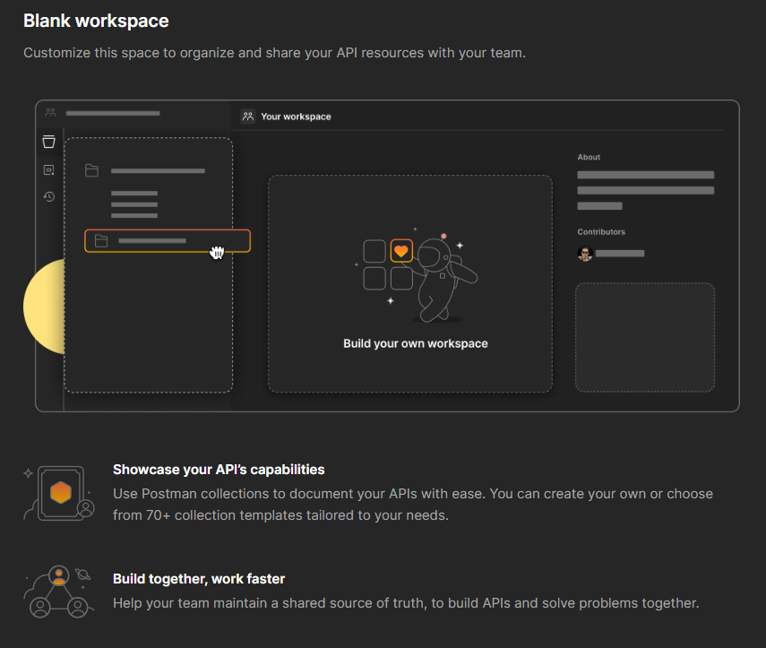



Boosting Team Collaboration
Shared Workspaces
Create shared workspaces for your team to collaborate on API projects.
Version History
Track changes and collaborate efficiently with version history and rollback capabilities.
Team Communication
Built-in communication tools facilitate seamless collaboration and feedback.

Slide 8

Q&A and Conclusion
How does Postman make version control easier?
How does Postman help with API testing beyond just sending requests?
Can Postman be used for continuous integration (CI) testing?
Whether you're a developer working on a side project or part of a large team,
Postman is here to make your life easier.

